Slide 1


Chapter 4
Greedy
Algorithms
Slides by Kevin Wayne.
Copyright © 2005 Pearson-Addison Wesley.
All rights reserved.

Slide 2
Coin Changing
Notes:
"michael douglas played gordon gecko in iconic movie of the 1980's that embodied Reagan era"
also starring charlie and martin sheen, directed by Oliver Stone

Slide 3







Coin Changing
Goal. Given currency denominations: 1, 5, 10, 25, 100, devise a method to pay amount to customer using fewest number of coins.
Ex: 34¢.
Cashier's algorithm. At each iteration, add coin of the largest value that does not take us past the amount to be paid.
Ex: $2.89.
Notes:
most of us solve this kind of problem every day without thinking twice, unconsciously using an obvious greedy algorithm
http://www.frbatlanta.org/publica/brochure/fundfac/html/coinfaces.html

Slide 4
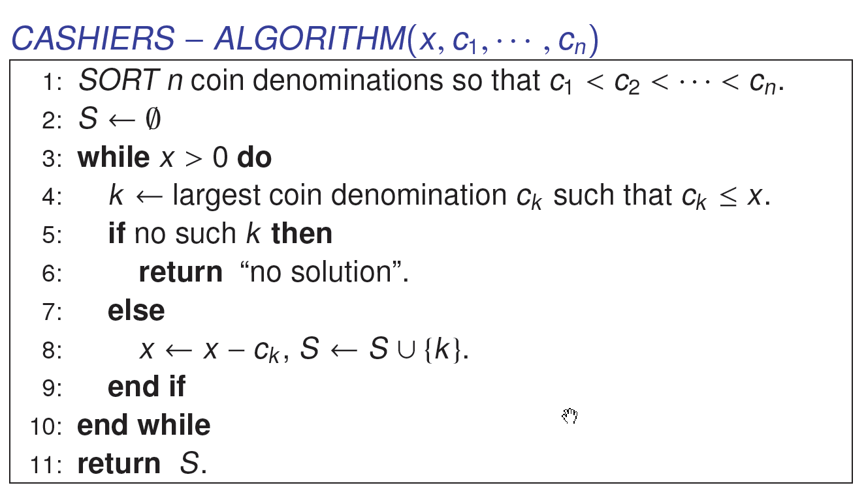
Coin-Changing: Greedy Algorithm
Q. Is cashier's algorithm optimal?
Notes:
takes O(n log n) + |S| where S is the number of coins taken by greedy
Note: can be sped up somewhat by using integer division

Slide 5
Coin-Changing: Analysis of Greedy Algorithm
Theorem. Greed is optimal for U.S. coinage: 1, 5, 10, 25, 100.
Pf. (by induction on x)
  Consider optimal way to change c_{k} ≤ x < c_{k+1} : greedy takes coin k.
  We claim that any optimal solution must also take coin k.
    if not, it needs enough coins of type c₁, …, c_{k-1} to add up to x
    table below indicates no optimal solution can do this
  Problem reduces to coin-changing x - c_{k} cents, which, by induction, is optimally solved by greedy algorithm. ▪
k
c_{k}
All optimal solutions
must satisfy
Max value of coins
1, 2, …, k-1 in any OPT
1
1
P ≤ 4
-
2
5
N ≤ 1
4
3
10
N + D ≤ 2
4 + 5 = 9
4
25
Q ≤ 3
20 + 4 = 24
5
100
no limit
75 + 24 = 99
Notes:
P = pennies, N = nickels, D = dimes, Q = quarters

Slide 6
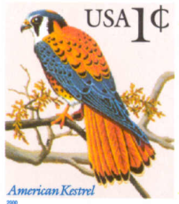
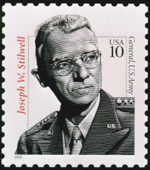

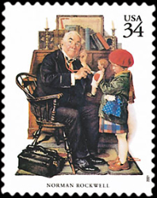




Coin-Changing: Analysis of Greedy Algorithm
Observation. Greedy algorithm is sub-optimal for US postal denominations: 1, 10, 21, 34, 70, 100, 350, 1225, 1500.
Counterexample. 140¢.
  Greedy: 100, 34, 1, 1, 1, 1, 1, 1.
  Optimal: 70, 70.
Notes:
note: may not even lead to *feasible* solution if c_1 > 1!
Ex. C = {7, 8, 9}, x = 15

Slide 7
4.1 Interval Scheduling

Slide 8
Interval Scheduling
Interval scheduling.
  Job j starts at s_{j} and finishes at f_{j}.
  Two jobs compatible if they don't overlap.
  Goal: find maximum subset of mutually compatible jobs.
a
b
c
d
e
f
g
h
Time
0
1
2
3
4
5
6
7
8
9
10
11
Notes:
Activity selection = interval scheduling
OPT = B, E, H
Note: smallest job (C) is not in any optimal solution, job that starts first (A) is not in any optimal solution.

Slide 9
Interval Scheduling: Greedy Algorithms
Greedy template. Consider jobs in some order. Take each job provided it's compatible with the ones already taken.
  [Earliest start time] Consider jobs in ascending order of start time s_{j}.
  [Earliest finish time] Consider jobs in ascending order of finish time f_{j}.
  [Shortest interval] Consider jobs in ascending order of interval length f_{j} - s_{j}.
  [Fewest conflicts] For each job, count the number of conflicting jobs c_{j}. Schedule in ascending order of conflicts c_{j}.

Slide 10
Interval Scheduling: Greedy Algorithms
Greedy template. Consider jobs in some order. Take each job provided it's compatible with the ones already taken.
breaks earliest start time
breaks shortest interval
breaks fewest conflicts

Slide 11
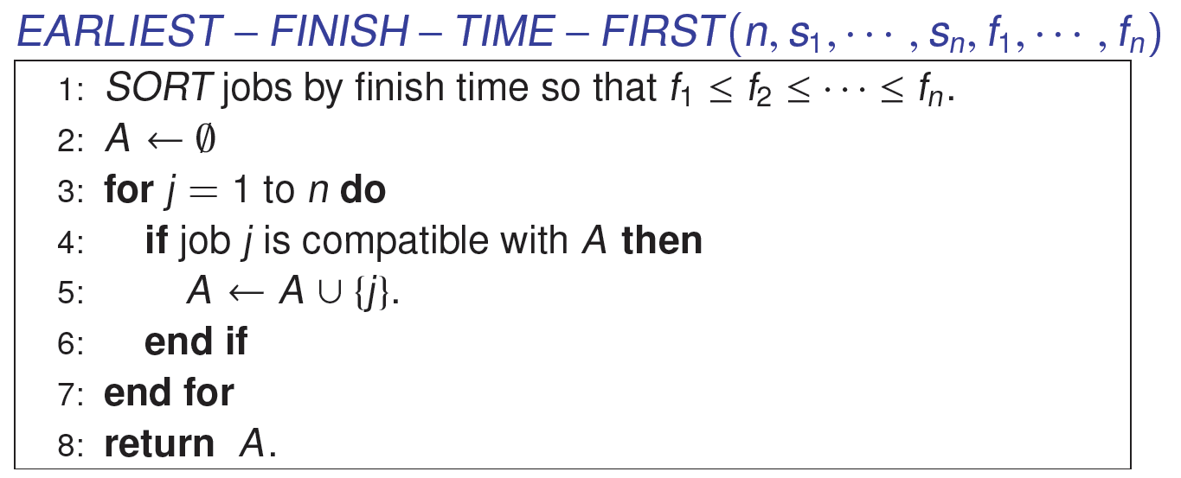
Interval Scheduling: Greedy Algorithm
Greedy algorithm. Consider jobs in increasing order of finish time. Take each job provided it's compatible with the ones already taken.
Implementation. O(n log n).
  Remember job j* that was added last to A.
  Job j is compatible with A if s_{j} ≥ f_{j*}.

Slide 12
Interval Scheduling: Analysis
Theorem. Greedy algorithm is optimal.
Pf. (by contradiction)
  Assume greedy is not optimal, and let's see what happens.
  Let i₁, i₂, ... i_{k} denote set of jobs selected by greedy.
  Let j₁, j₂, ... j_{m} denote set of jobs in the optimal solution with
  i₁ = j₁, i₂ = j₂, ..., i_{r} = j_{r} for the largest possible value of r.
job i_{r+1} finishes before j_{r+1}
Greedy:
i₁
i₁
i_{r}
i_{r+1}
OPT:
j₁
j₂
j_{r}
j_{r+1}
. . .
why not replace job j_{r+1}
with job i_{r+1}?

Slide 13
Interval Scheduling: Analysis
Theorem. Greedy algorithm is optimal.
Pf. (by contradiction)
  Assume greedy is not optimal, and let's see what happens.
  Let i₁, i₂, ... i_{k} denote set of jobs selected by greedy.
  Let j₁, j₂, ... j_{m} denote set of jobs in the optimal solution with
  i₁ = j₁, i₂ = j₂, ..., i_{r} = j_{r} for the largest possible value of r.
job i_{r+1} finishes before j_{r+1}
Greedy:
i₁
i₁
i_{r}
i_{r+1}
OPT:
j₁
j₂
j_{r}
i_{r+1}
. . .
solution still feasible and optimal, but contradicts maximality of r.

Slide 14
4.1 Interval Partitioning

Slide 15
Interval Partitioning
Interval partitioning.
  Lecture j starts at s_{j} and finishes at f_{j}.
  Goal: find minimum number of classrooms to schedule all lectures so that no two occur at the same time in the same room.
Ex: This schedule uses 4 classrooms to schedule 10 lectures.
e
j
c
d
g
b
h
a
f
i
9
9:30
10
10:30
11
11:30
12
12:30
1
1:30
2
2:30
3
3:30
4
4:30
Time

Slide 16
Interval Partitioning
Interval partitioning.
  Lecture j starts at s_{j} and finishes at f_{j}.
  Goal: find minimum number of classrooms to schedule all lectures so that no two occur at the same time in the same room.
Ex: This schedule uses only 3.
c
d
f
j
b
g
i
a
e
h
9
9:30
10
10:30
11
11:30
12
12:30
1
1:30
2
2:30
3
3:30
4
4:30
Time

Slide 17
Interval Partitioning: Lower Bound on Optimal Solution
Def. The depth of a set of open intervals is the maximum number that contain any given time.
Key observation. Number of classrooms needed ≥ depth.
Ex: Depth of schedule below = 3 ⇒ schedule below is optimal.
Q. Does there always exist a schedule equal to depth of intervals?
a, b, c all contain 9:30
c
d
f
j
b
g
i
a
e
h
9
9:30
10
10:30
11
11:30
12
12:30
1
1:30
2
2:30
3
3:30
4
4:30
Time

Slide 18
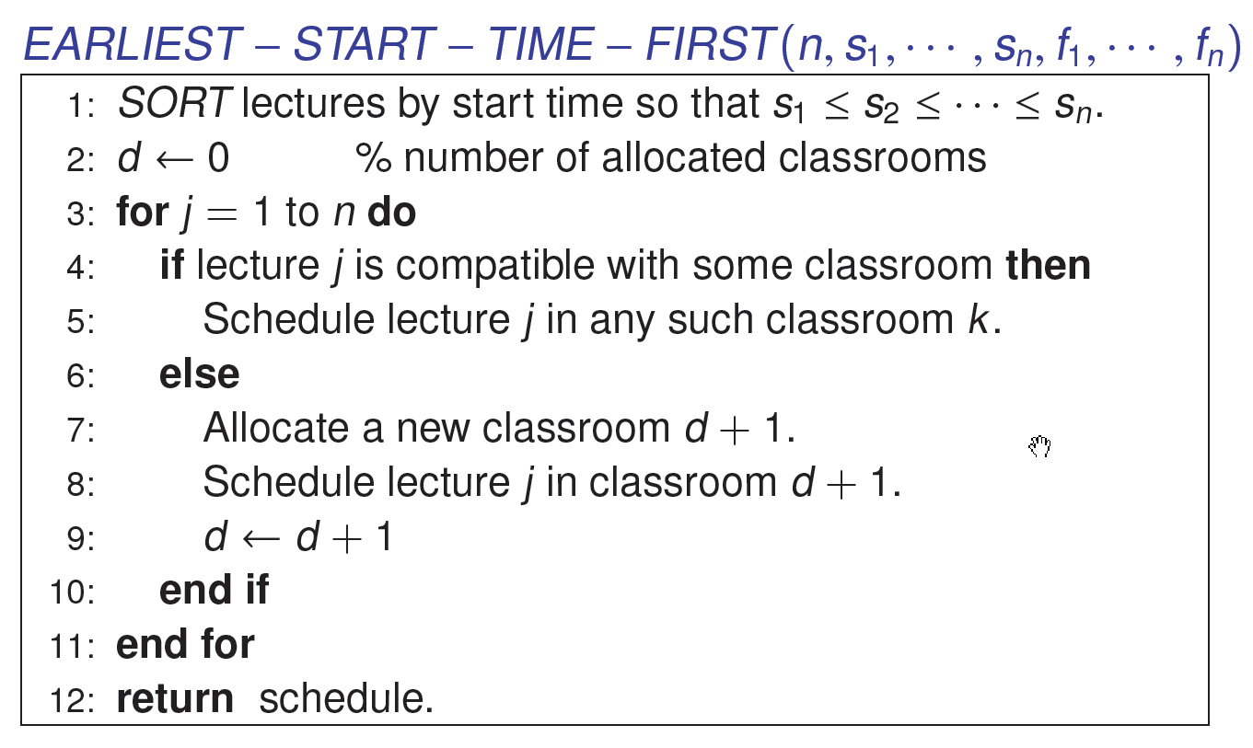
Interval Partitioning: Greedy Algorithm
Implementation. O(n log n).

Slide 19
Interval Partitioning: Greedy Analysis
Observation. Greedy algorithm never schedules two incompatible lectures in the same classroom.
Theorem. Greedy algorithm is optimal.
Pf.
  Let d = number of classrooms that the greedy algorithm allocates.
  Classroom d is opened because we needed to schedule a job, say j, that is incompatible with all d-1 other classrooms.
  Since we sorted by start time, all these incompatibilities are caused by lectures that start no later than s_{j}.
  Thus, we have d lectures overlapping at time s_{j} + ε.
  Key observation ⇒ all schedules use ≥ d classrooms. ▪

Slide 20
4.2 Scheduling to Minimize Lateness

Slide 21
Scheduling to Minimizing Lateness
Minimizing lateness problem.
  Single resource processes one job at a time.
  Job j requires t_{j} units of processing time and is due at time d_{j}.
  If j starts at time s_{j}, it finishes at time f_{j} = s_{j} + t_{j}.
  Lateness: _{j} = max { 0, f_{j} - d_{j} }.
  Goal: schedule all jobs to minimize maximum lateness L = max _{j}.
Ex:
1
2
3
4
5
6
t_{j}
3
2
1
4
3
2
d_{j}
6
8
9
9
14
15
lateness = 2
lateness = 0
max lateness = 6
d₃ = 9
d₂ = 8
d₆ = 15
d₁ = 6
d₅ = 14
d₄ = 9
0
1
2
3
4
5
6
7
8
9
10
11
12
13
14
15
Notes:
Note: finding a maximal size subset of jobs that meet deadline is NP-hard.

Slide 22
Minimizing Lateness: Greedy Algorithms
Greedy template. Consider jobs in some order.
  [Shortest processing time first] Consider jobs in ascending order of processing time t_{j}.
  [Earliest deadline first] Consider jobs in ascending order of deadline d_{j}.
  [Smallest slack] Consider jobs in ascending order of slack d_{j} - t_{j}.

Slide 23
Minimizing Lateness: Greedy Algorithms
Greedy template. Consider jobs in some order.
  [Shortest processing time first] Consider jobs in ascending order of processing time t_{j}.
  [Smallest slack] Consider jobs in ascending order of slack d_{j} - t_{j}.
1
2
t_{j}
1
10
counterexample
d_{j}
100
10
1
2
t_{j}
1
10
counterexample
d_{j}
2
10

Slide 24
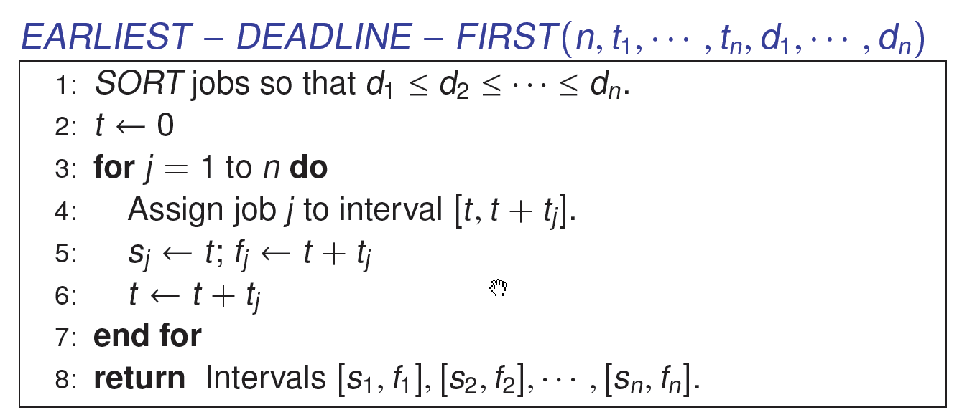
Minimizing Lateness: Greedy Algorithm
Greedy algorithm. Earliest deadline first.
max lateness = 1
d₁ = 6
d₂ = 8
d₃ = 9
d₄ = 9
d₅ = 14
d₆ = 15
0
1
2
3
4
5
6
7
8
9
10
11
12
13
14
15

Slide 25
Minimizing Lateness: No Idle Time
Observation. There exists an optimal schedule with no idle time.
Observation. The greedy schedule has no idle time.
d = 4
d = 6
d = 12
0
1
2
3
4
5
6
7
8
9
10
11
d = 4
d = 6
d = 12
0
1
2
3
4
5
6
7
8
9
10
11
Notes:
"machine not working for some reason, yet work still to be done"

Slide 26
Minimizing Lateness: Inversions
Def. An inversion in schedule S is a pair of jobs i and j such that:
i < j but j scheduled before i.
Observation. Greedy schedule has no inversions.
Observation. If a schedule (with no idle time) has an inversion, it has one with a pair of inverted jobs scheduled consecutively.
inversion
before swap
j
i
Notes:
Recall: jobs sorted in ascending order of due dates

Slide 27
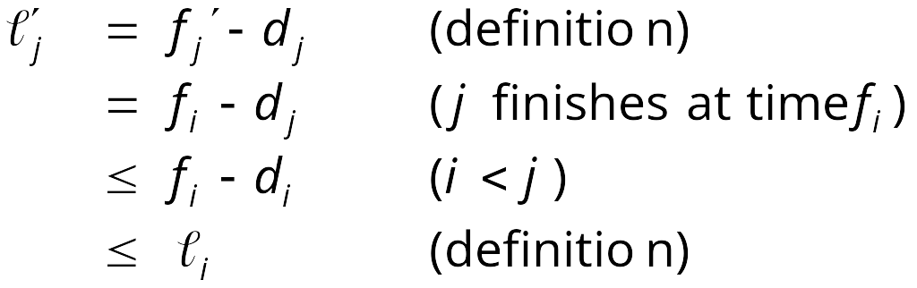
Minimizing Lateness: Inversions
Def. An inversion in schedule S is a pair of jobs i and j such that:
i < j but j scheduled before i.
Claim. Swapping two adjacent, inverted jobs reduces the number of inversions by one and does not increase the max lateness.
Pf. Let  be the lateness before the swap, and let  ' be it afterwards.
  '_{k} = _{k} for all k ≠ i, j
  '_{i} ≤ _{i}
  If job j is late:
inversion
f_{i}
before swap
j
i
after swap
i
j
f'_{j}

Slide 28
Minimizing Lateness: Analysis of Greedy Algorithm
Theorem. Greedy schedule S is optimal.
Pf. Define S* to be an optimal schedule that has the fewest number of inversions, and let's see what happens.
  Can assume S* has no idle time.
  If S* has no inversions, then S = S*.
  If S* has an inversion, let i-j be an adjacent inversion.
    swapping i and j does not increase the maximum lateness and strictly decreases the number of inversions
    this contradicts definition of S* ▪

Slide 29
Greedy Analysis Strategies
Greedy algorithm stays ahead. Show that after each step of the greedy algorithm, its solution is at least as good as any other algorithm's.
Exchange argument. Gradually transform any solution to the one found by the greedy algorithm without hurting its quality.
Structural. Discover a simple "structural" bound asserting that every possible solution must have a certain value. Then show that your algorithm always achieves this bound.
Notes:
myopic
greed: "at every iteration, the algorithm chooses the best morsel it can swallow, without worrying about the future"
Objective function. Does not explicitly appear in greedy algorithm!
Hard, if not impossible, to precisely define "greedy algorithm."

Slide 30
4.3 Optimal Caching

Slide 31
Optimal Offline Caching
Caching.
  Cache with capacity to store k items.
  Sequence of m item requests d₁, d₂, …, d_{m}.
  Cache hit: item already in cache when requested.
  Cache miss: item not already in cache when requested: must bring requested item into cache, and evict some existing item, if full.
Goal. Eviction schedule that minimizes number of cache misses.
Ex: k = 2, initial cache = ab,
requests: a, b, c, b, c, a, a, b.
Optimal eviction schedule: 2 cache misses.
a
a
b
b
a
b
c
c
b
b
c
b
c
c
b
a
a
b
a
a
b
b
a
b
requests
cache

Slide 32
Optimal Offline Caching: Farthest-In-Future
Farthest-in-future. Evict item in the cache that is not requested until farthest in the future.
Theorem. [Bellady, 1960s] FF is optimal eviction schedule.
Pf. Algorithm and theorem are intuitive; proof is subtle.
current cache:
a
b
c
d
e
f
future queries:
g a b c e d a b b a c d e a f a d e f g h ...
cache miss
eject this one

Slide 33
Reduced Eviction Schedules
Def. A reduced schedule is a schedule that only inserts an item into the cache in a step in which that item is requested.
Intuition. Can transform an unreduced schedule into a reduced one with no more cache misses.
a
a
b
c
a
a
b
c
a
a
x
c
a
a
b
c
c
a
d
c
c
a
b
c
d
a
d
b
d
a
d
c
a
a
c
b
a
a
d
c
b
a
x
b
b
a
d
b
c
a
c
b
c
a
c
b
a
a
b
c
a
a
c
b
a
a
b
c
a
a
c
b
an unreduced schedule
a reduced schedule

Slide 34
Claim. Given any unreduced schedule S, can transform it into a reduced schedule S' with no more cache misses.
Pf.
  Suppose S brings d into the cache at time t, without a request.
  Let c be the item S evicts when it brings d into the cache.
  Case 1: d evicted at time t', before next request for d.
  Case 2: d requested at time t' before d is evicted. ▪
S
S'
S
S'
c
c
c
c
t
t
t
t
d
d
t'
t'
t'
t'
e
d evicted at time t',
before next request
e
d requested at time t'
d
Case 1
Case 2
Notes:
Note: can't assume a priori that events in unreduced schedule occur solely at request times

Slide 35
Farthest-In-Future: Analysis
Theorem. FF is optimal eviction algorithm.
Pf. (by induction on number of requests j)
Let S be reduced schedule that satisfies invariant through j requests. We produce S' that satisfies invariant after j+1 requests.
  Consider (j+1)^{st} request d = d_{j+1}.
  Since S and S_{FF} have agreed up until now, they have the same cache contents before request j+1.
  Case 1: (d is already in the cache). S' = S satisfies invariant.
  Case 2: (d is not in the cache and S and S_{FF} evict the same element).
  S' = S satisfies invariant.
Invariant: There exists an optimal reduced schedule S that makes the same eviction schedule as S_{FF} through the first j+1 requests.

Slide 36
j
same
e
f
same
e
f
S
S'
j+1
same
e
d
same
d
f
j
S
S'

Slide 37
Farthest-In-Future: Analysis
Let j' be the first time after j+1 that S and S' take a different action, and let g be item requested at time j'.
  Case 3a: g = e. Can't happen with Farthest-In-Future since there must be a request for f before e.
  Case 3b: g = f. Element f can't be in cache of S, so let e' be the element that S evicts.
    if e' = e, S' accesses f from cache; now S and S' have same cache
    if e' ≠ e, S' evicts e' and brings e into the cache; now S and S' have the same cache
must involve e or f (or both)
j'
same
e
same
f
S
S'
Note: S' is no longer reduced, but can be transformed into
a reduced schedule that agrees with S_{FF} through step j+1

Slide 38
Farthest-In-Future: Analysis
Let j' be the first time after j+1 that S and S' take a different action, and let g be item requested at time j'.
  Case 3c: g ≠ e, f. S must evict e.
  Make S' evict f; now S and S' have the same cache. ▪
must involve e or f (or both)
j'
same
e
same
f
S
S'
otherwise S' would take the same action
j'
same
g
same
g
S
S'

Slide 39
Caching Perspective
Online vs. offline algorithms.
  Offline: full sequence of requests is known a priori.
  Online (reality): requests are not known in advance.
  Caching is among most fundamental online problems in CS.
LIFO. Evict page brought in most recently.
LRU. Evict page whose most recent access was earliest.
Theorem. FF is optimal offline eviction algorithm.
  Provides basis for understanding and analyzing online algorithms.
  LRU is k-competitive. [Section 13.8]
  LIFO is arbitrarily bad.
FF with direction of time reversed!

Slide 40
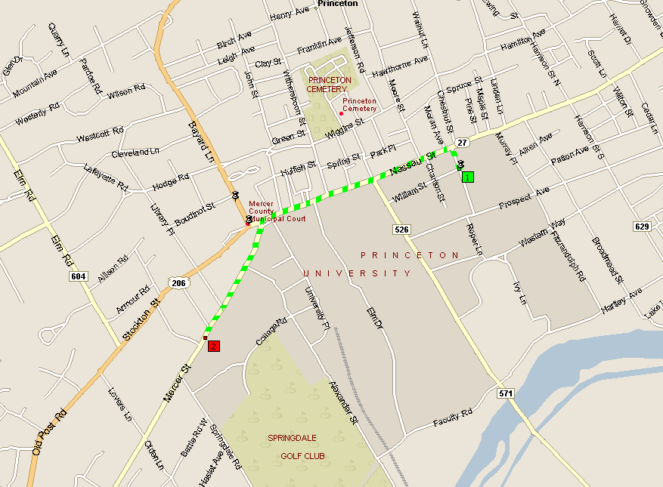
4.4 Shortest Paths in a Graph
shortest path from Princeton CS department to Einstein's house
Notes:
map from Microsoft Streets and Trips

Slide 41
Shortest Path Problem
Shortest path network.
  Directed graph G = (V, E).
  Source s, destination t.
  Length _{e} ≥0, length of edge e.
Shortest path problem: find shortest directed path from s to t.
cost of path = sum of edge costs in path
2
23
3
9
s
18
Cost of path s-2-3-5-t
= 9 + 23 + 2 + 16
= 48.
14
2
6
6
30
4
19
15
5
11
5
6
20
16
7
t
44

Slide 42

Dijkstra's Algorithm
Dijkstra's algorithm.
  Maintain a set of explored nodes S for which we have determined the shortest path distance d(u) from s to u.
  Initialize S = { s }, d(s) = 0.
  Repeatedly choose unexplored node v which minimizes
  add v to S, and set d(v) = π(v).
shortest path to some u in explored part, followed by a single edge (u, v)
_{e}
v
d(u)
u
S
s

Slide 43
Dijkstra's Algorithm
Dijkstra's algorithm.
  Maintain a set of explored nodes S for which we have determined the shortest path distance d(u) from s to u.
  Initialize S = { s }, d(s) = 0.
  Repeatedly choose unexplored node v which minimizes
  add v to S, and set d(v) = π(v).
shortest path to some u in explored part, followed by a single edge (u, v)
_{e}
v
d(u)
u
S
s
Notes:
S is only needed for the proof of correctness, not the algorithm itself

Slide 44
Dijkstra's Algorithm: Proof of Correctness
Invariant. For each node u ∈ S, d(u) is the length of the shortest s-u path.
Pf. (by induction on |S|)
Base case: |S| = 1 is trivial.
Inductive hypothesis: Assume true for |S| = k ≥ 1.
  Let v be next node added to S, and let u-v be the chosen edge.
  The shortest s-u path plus (u, v) is an s-v path of length π(v).
  Consider any s-v path P. We'll see that it's no shorter than π(v).
  Let x-y be the first edge in P that leaves S,
  and let P' be the subpath to x.
  P is already too long as soon as it leaves S.
P
P'
x
y
s
S
u
● (P) ≥  (P') +  (x,y) ≥ d(x) +  (x, y) ≥ π(y) ≥ π(v)
v
nonnegative
weights
inductive
hypothesis
defn of π(y)
Dijkstra chose v
instead of y
Notes:
Consider any path P from s to v. It is already at least as long as π(v) by the time it leaves S.

Slide 45
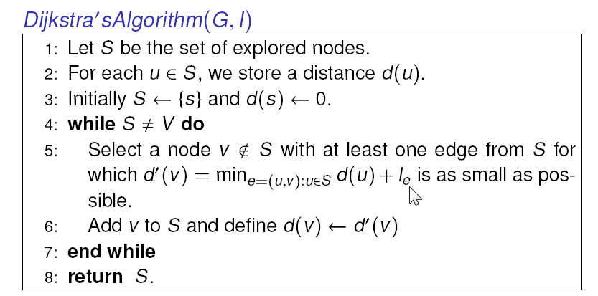
Dijkstra's Algorithm

Slide 46


Dijkstra's Algorithm: Implementation
For each unexplored node, explicitly maintain
  Next node to explore = node with minimum π(v).
  When adding v, for each incident edge e = (v, w), update
Efficient implementation. Dijkstra’s algorithm can find the shortest path in O(n²) time.
Priority Queue

Slide 47
Homework
Read Chapter 4 of the textbook.
Exercises 4, 6, 7 & 13 in Chapter 4.

